Slide 1




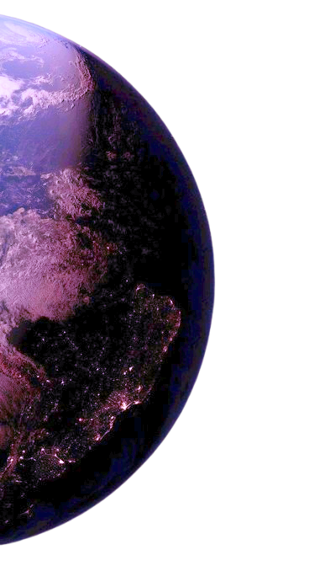

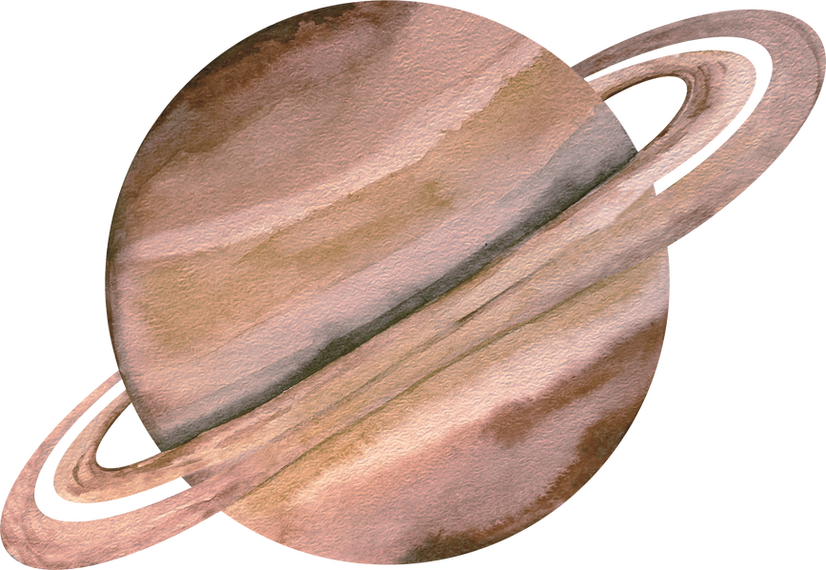
EXPLORE
MUSEUM MAP
ABOUT US
THE UNIVERSE COMES ALIVE BEFORE YOUR EYES
COSMIC
MUSEUM
GET STARTED

Slide 2

DISCOVERS THE GALAXY AND THE PLANETS
EDUCATIONAL DISPLAY
HANDS ON ACTIVITIES
RETURN

Slide 3
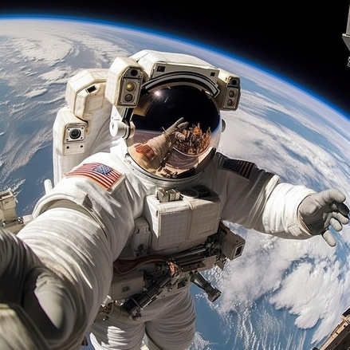

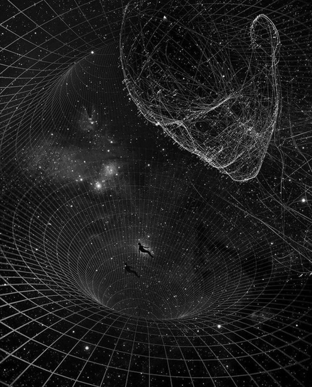

EXPLORE
a
SPACE ZONE
HISTORY
SIMULATION
RETURN

Slide 4
EXPLORE
THE BIG BANG
HISTORY
THE BIG BANG THEORY IS THE MOST
WIDELY ACCEPTED
SCIENTIFIC EXPLANATION FOR THE
SPACE ZONE
SIMULATION
ORIGIN OF THE UNIVERSE.
IT SUGGESTS THAT
THE UNIVERSE BEGAN
AS AN INFINITELY SMALL, HOT,
TO SPACE, TIME, MATTER, AND ENERGY.
ABOUT 13.8 BILLION YEARS AGO, GIVING RISE
AND DENSE POINT, WHICH SUDDENLY EXPANDED
RETURN

Slide 5
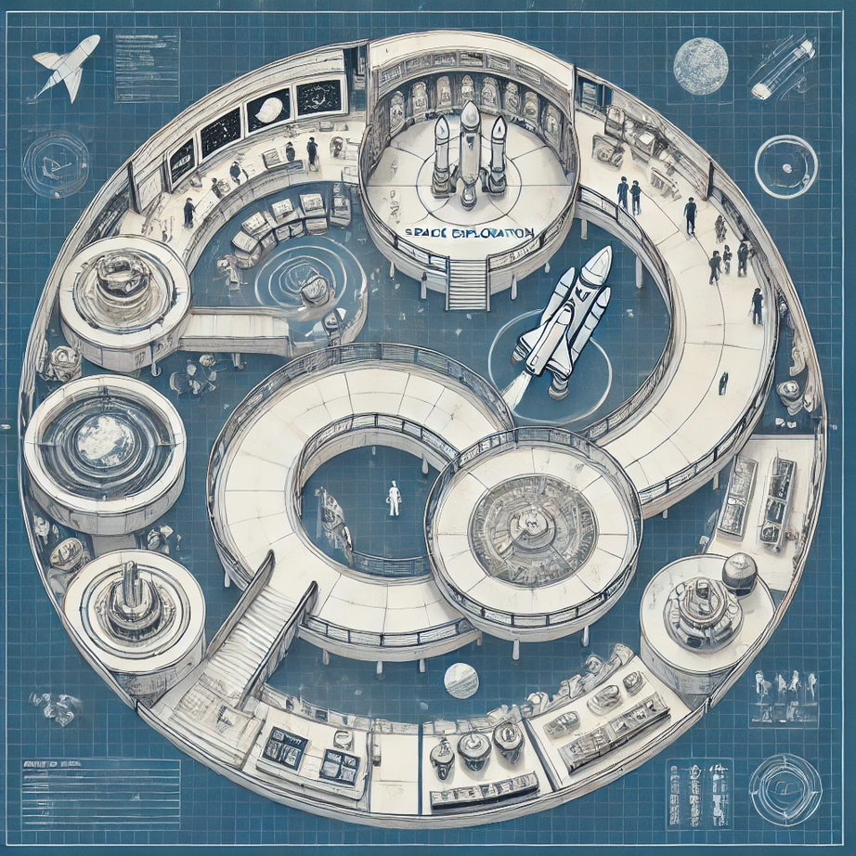
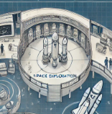
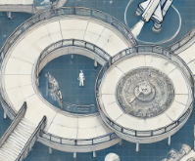


MUSEUM MAP
INTERACTIVE MAP
RETURN

Slide 6
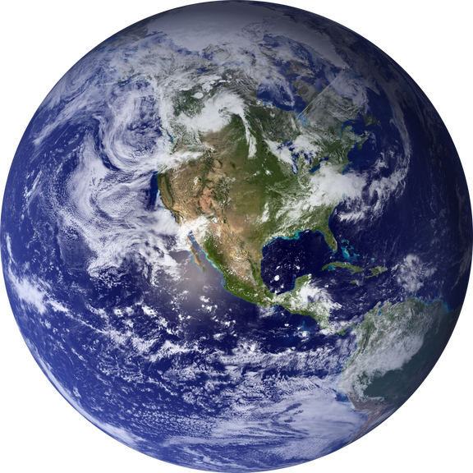


ABOUT US
WELCOME TO THE COSMIC MUSEM A PLACE WHERE THE WONDERS OF THE COSMOS COME TO LIFE! OUR MUSEUM IS DEDICATED TO EXPLORING THE MYSTERIES OF PLANETS, STARS, AND GALAXIES, BRINGING THE UNIVERSE CLOSER TO CURIOUS MINDS OF ALL AGES.
WE BELIEVE THAT SPACE EXPLORATION FUELS IMAGINATION, DISCOVERY, AND INNOVATION. WHETHER YOU'RE A STUDENT, AN ASPIRING ASTRONOMER, OR JUST FASCINATED BY THE COSMOS, OUR MUSEUM OFFERS AN UNFORGETTABLE EXPERIENCE THAT SPARKS CURIOSITY AND DEEPENS UNDERSTANDING OF THE UNIVERSE.
JOIN US ON AN EXTRAORDINARY VOYAGE THROUGH SPACE AND TIME. THE UNIVERSE IS WAITING—LET’S EXPLORE IT TOGETHER!
CONTACT US
📍 ADDRESS: 054, ST WILLIAMS, USA
📞 PHONE: 455-033-6784
✉️ EMAIL: COSMICMUSE@GMAIL.COM
RETURN

Slide 7
EXPLORE
MUSEUM MAP
ABOUT US
THE UNIVERSE COMES ALIVE BEFORE YOUR EYES
COSMIC
MUSEUM

